Slide 1
Originally presented in:
The American Institute of Ultrasound in Medicine 2015 PreConvention March 21- 25 Orlando
Elastography: State of the Art 2015

Slide 2
Conflict of Interest:
- Toshiba MS: expert, member of the advisory board
- Philips US: expert, member of the advisory board
- SuperSonic Imagine: expert and lecturer
- General Electric: expert and lecturer
- Bracco SA: principal investigator of BR1-127 protocol
- Guerbet SA: principal investigator of NsSafe and Secure protocol, lecturer
-Magnawave International: member of the advisory board
a

Slide 3
OUTLINE
• PC epidemiology
• Limitation of current diagnostic tests
• Prostate elastography: - techniques - acquisition - normal pattern - cancer pattern - performance - limitations
• Conclusion and perspectives

Slide 4
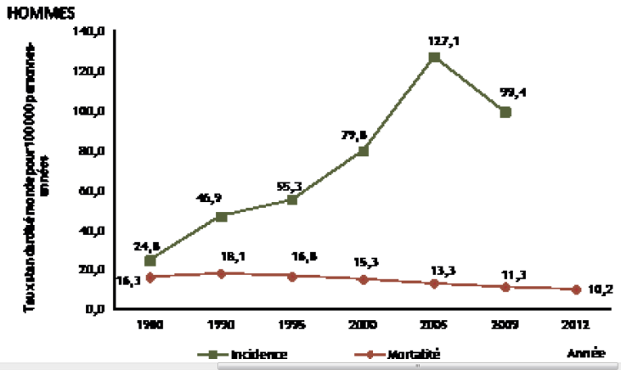
PROSTATE CANCER
• 2nd leading cause of cancer death in men
• Most common diagnosed malignancy in men France: 200,000 new cancers in men with 56841 PC (28%) Cancer death in men: 85000 including 8876 for PC (10%)
USA 2012: PC: 790,000 cases and 241,740 new cases => cancer-related death≈ 30.000/year (2008, USA)
• Evolution: slight incidence decrease annual death rate & mortality: slight ⇓ BUT strong 5-year survival rate increase (30% in 25 Y; 98%) Low grade followed by imaging
Source : Binder-Foucard F, 2013.Traitement : INCa 2013

Slide 5
LIMITATION OF DIAGNOSTIC TESTS
● Limited performance of diagnostic tests including PSA, TRUS, MRI and biopsy
● Large room for improvements in prostate imaging => Transrectal Prostate Elastography: Strain vs ShearWave Elasto
30% false positive MRI from prostatitis=T2 noncontrast scan protocols
● PSA: Non specific elevation (cancer, Benign Prostatic Hyperplasia, acute prostatitis, abscess/infarct, traumatisms (cystoscopy…)) Normal dosage < 4 ng/ml (immuno-enzymatic, monoclonal) To increase specificity: age-specific PSA, PSA density, PSA velocity (rate of rise) free to total PSA ratio (% free PSA)
BUT 20% of cancer => PSA< 4 ng/ml

Slide 6
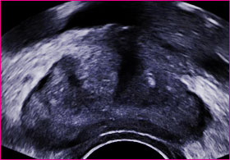
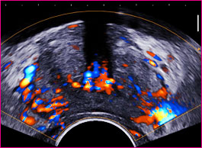
LIMITATION OF DIAGNOSTIC TESTS Transrectal Ultrasound
• Limited TRUS sensitivity ( 40-60%) for PC detection
- B-mode Imaging: hypoechoic nodule in 50-80% but hyperechoic/heterogeneous in larger lesions and isoechoic in 20-30%
- Color-Doppler US: typically hypervascular but not specific - 3D Doppler Histogram for monitoring
A normal TRUS examination should not delay prostate biopsies if abnormal digital rectal examination/ PSA values

Slide 7
LIMITATION OF DIAGNOSTIC TESTS Multi-Parametric MRI
• MRI: MP imaging (T2w, diffusion, DCE-MRI, spectroscopy) => a major tool for cancer detection and staging significant PC - High detection rate (Se 58-96%) and NPV (63-98%)* - BUT low specificity (23-87%) and limited accuracy (44-87%) - Additional limitations: cost, availability, tolerance biopsy guidance with fusion
*Bard R, Fütterer JJ, IMAGE GUIDED PROSTATE CANCER TREATMENT Springer 2019
Be Detected with Multiparametric Magnetic Resonance Imaging? A Systematic Review of the Literature. Eur Urol (2015), http://dx.doi.org/10.1016 ** Le JD, et al. Multifocality and Prostate Cancer Detection by Multiparametric Magnetic Resonance Imaging: Correlation with Whole-mount Histopathology.Eur Urol. 2014 Sep 22

Slide 8
LIMITATION OF DIAGNOSTIC TESTS Prostate biopsies
• Prostate biopsies: - systematic posterior sextant biopsies in PZ with various sampling protocols (12 cores)
- additional targeted biopsies on US/MRI abnormalities
- provide diagnosis of cancer and grade (Gleason score) - BUT false negative rate of 17-21% positive biopsy rate 30-60% depending on PSA values - Additional limitations: cost (procedure, pathology, complications, g^{al} anesthesia), tolerance and complications (bleeding, infection) in some cases: hospitalization, general anesthesia…
Matlaga BR J Urol 2003; Djavan BJ Urol 2001

Slide 9
QUASI-STATIC/STRAIN ELASTOGRAPHY
● Soft tissue => higher strain (deformation) linked by the Young’s modulus E = σ (stress) / ε (resulting strain)
● Speckle comparison => color map of local tissue deformation in a sub region (compression by the transducer) => elastogram
● Stress supposed to be uniform in space and intensity => improved by a water filled balloon?
Tsutsumi M. AJR 2010

Slide 10
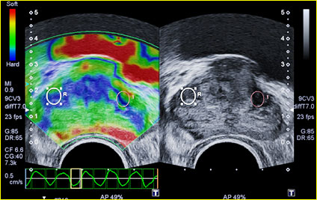
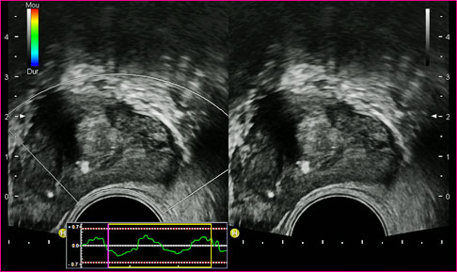
QUASI-STATIC/STRAIN ELASTOGRAPHY
● Stiffness estimated by visualization of the differences between adjacent regions
● No quantitative elasticity analysis available semi quantitative information using strain ratio between 2 ROI
● Color scale distributed between highest and lowest strain found in ROI => variation due to ROI size and position => different stiffness with ROI size

Slide 11
SHEAR WAVE ELASTOGRAPHY PRINCIPLES
Step 1
STEP 2
Step 3
Radiation Force:
Shear wave generation by inducing local excitation
UltraFast Imaging:
Shear wave propagation is captured with planes waves
Quantification processing:
From velocity movie to elasticity
_{MultiWave™ Interaction}
Total time: 20 ms
Acquisition speeds of up to 20,000 Hz
₁₁

Slide 12
Prostate US elastography Performing acquisition
• B-mode examination kidneys+bladder (post voiding bladder volume)
• Prostate TRUS B-mode and CDUS (transverse & sagittal): - left decubitus, prostate volume = image projected on screen/wall - suspicious areas (hypoechogenic, hypervascular) - prostate capsule, seminal vesicles
• Strain elastography: - just press elastography button - smooth compression – decompression cycles avoiding slippage artifacts (32%?) - suspicious lesion: hypoechogenic + increased stiffness (blue) - store digital cineloop for review

Slide 13
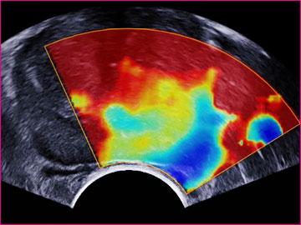
PROSTATE US ELASTOGRAPHY Performing acquisition
• SWE elastography: - in the appropriate preset and “PEN” option, scale 70-90 kPa - set the ROI to cover half of the gland (transverse) - avoid any pressure on the probe - wait until stabilization of signals (3 sec) - scan entire half prostate from base to apex - suspicious lesion: hypoechogenic + increased stiffness (red) calculation of elasticity in ROI (mean, SD, min, max) and ratio - store digital cineloop for review (up to 5 min)

Slide 14
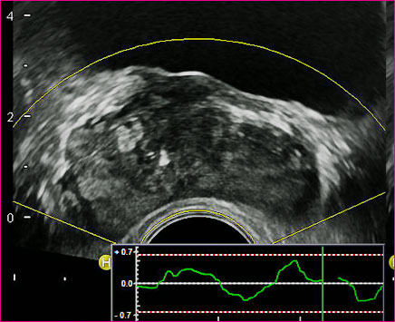
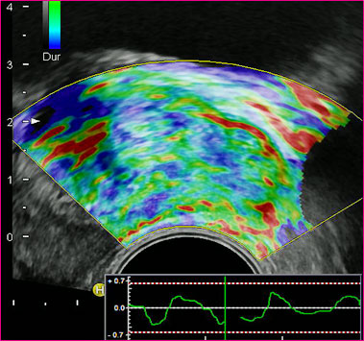
PROSTATE ELASTOGRAPHY Normal pattern
• Strain elastography: - PZ: homogeneous encoding with green and red colors (soft) - TZ: heterogeneous pattern with development of BPH

Slide 15
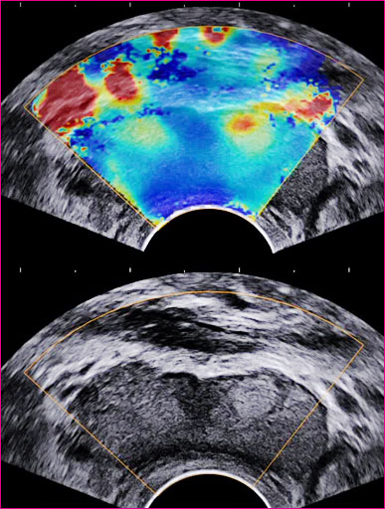
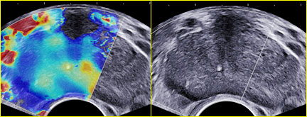
PROSTATE ELASTOGRAPHY Normal pattern
• SWE elastography: - PZ: homogeneous encoding with blue and green colors (soft tissue) - TZ: before BPH: PZ, CZ & ZC soft with elasticity< 30 kPa with BPH: CZ & TZ heterogeneous pattern 30 – 180 kPa
Calcifications => stiff area

Slide 16
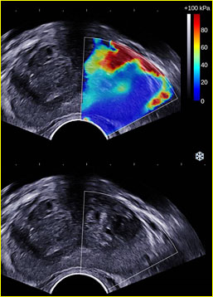
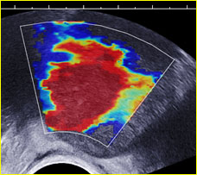
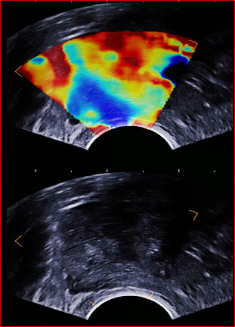
PROSTATE ELASTOGRAPHY Transition zone
• SWE elastography: - PZ: homogeneous encoding with blue and green colors (soft tissue) - TZ: before BPH: PZ, CZ & ZC soft with elasticity< 30 kPa with BPH: CZ & TZ heterogeneous pattern 30 – 180 kPa
Calcifications => stiff area

Slide 17
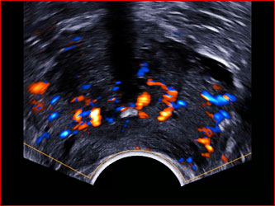
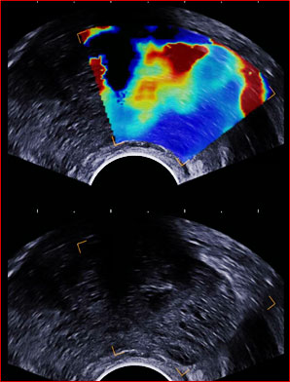
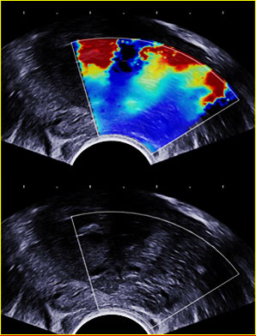
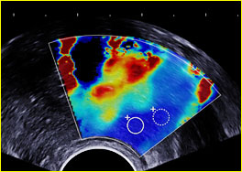
PROSTATE ELASTOGRAPHY BENIGN NODULE IN PZ (PROSTATITIS)

Slide 18
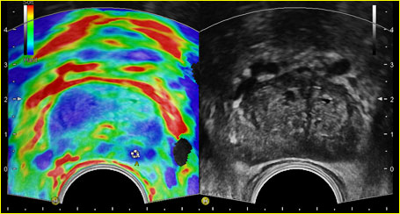
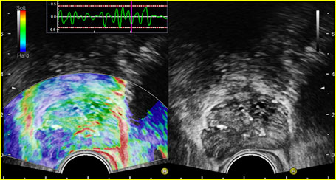
PROSTATE ELASTOGRAPHY SE cancer pattern
• Strain elastography: - heterogeneous stiff area coded in blue - with stable signals - involving capsule and peri prostatic fat in case of extension

Slide 19
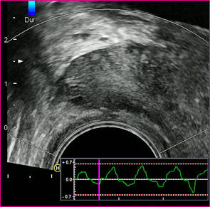
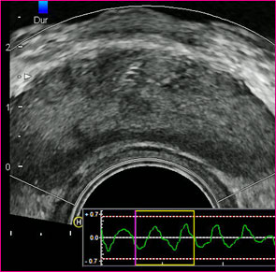
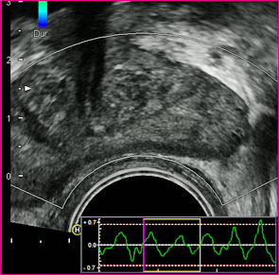
PROSTATE ELASTOGRAPHY SE cancer pattern
• Strain elastography: - heterogeneous stiff area coded in blue - difficult assessment in diffuse cancer disease

Slide 20
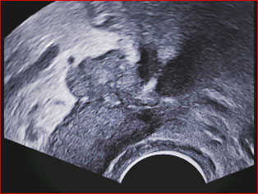
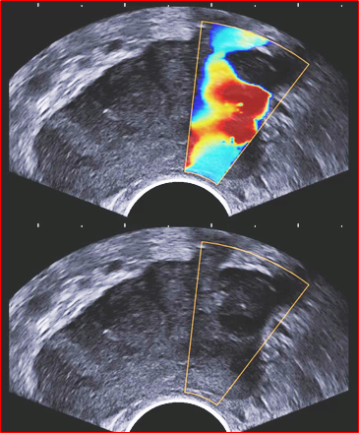
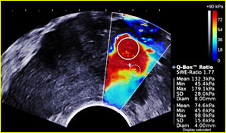
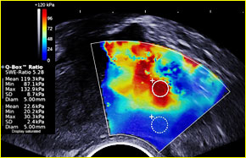
PROSTATE ELASTOGRAPHY SWE cancer pattern
• SW elastography: - heterogeneous stiff area coded in red in PZ - with stable signals

Slide 21
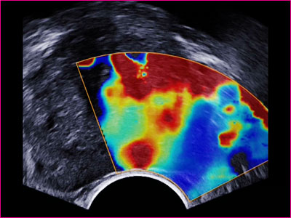
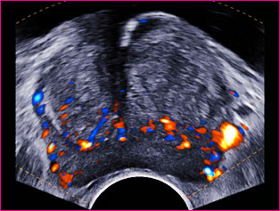
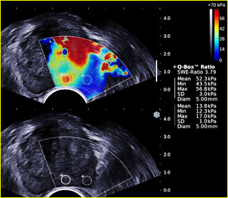
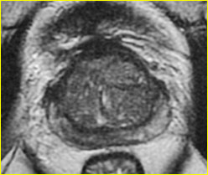
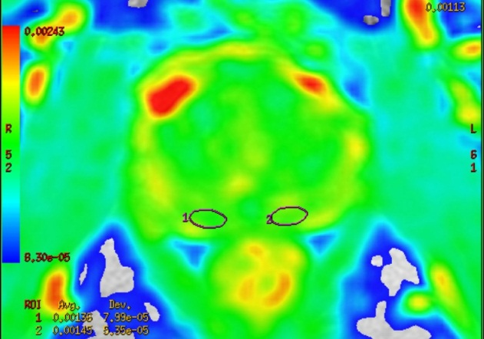
PROSTATE ELASTOGRAPHY SWE cancer pattern
Pathology: inflammation except in nodule biopsied=> 8 mm cancer Gleason 7

Slide 22
PROSTATE ELASTOGRAPHY SE performance in comparison to radical prostatectomy
• Studies with selection bias (known PC)
• Largest study 109 patients: Se 75.4 %, Spe 76.6 %, PPV 87.8 % and NPV 59.0 %
• Overall performance: Se 49% - 88%; Spe 65% - 89.5%
• PC detection rate increases with size and Gleason score => value for limitation of over diagnosis rate (up to 66%)
• SE improves detection of extracapsular extension (SE Se 38% vs B-mode Se 15%) with no change in Spe
Salomon G et al. Real-Time Elastography for the detection of Prostate Cancer Curr Urol Rep 2014; 15:392 Salomon G et al. Evaluation of prostate cancer detection with ultrasound real-time elastography: a comparison with step section pathological analysis after radical prostatectomy. Eur Urol. 2008;54(6):1354–62

Slide 23
PROSTATE ELASTOGRAPHY SE performance prior to random/targeted biopsy
• Limitations: study design retrospective, with random biopsy or targeted biopsies
• Random biopsy overall performance: Se 66-87%; Spe 62-78%
• Targeted biopsy studies using the most recent technology: Overall performance: Se 24.4% - 92%; Spe 60% - 100% PPV 12.2% - 75.8%; NPV 68.6% - 93.6%
Detection rate: RTE targeted biopsies 76% vs to TRUS targeted biopsies 65.6 %
Per core detection rate 4.7-fold higher within the RTE targeted biopsy cores
Salomon G et al. Real-Time Elastography for the detection of Prostate Cancer Curr Urol Rep 2014; 15:392 Pallwein L et al. Eur J Radiol. 2008;65(2):304–10
Zhang Y et al. Acta Radiol. 2012;53(1):119–26.

Slide 24
PROSTATE ELASTOGRAPHY Improvement of mp-MRI/TRUS fusion targeted biopsy using SE
• 121 men prospective 3T mp-MRI 2 fusion guided targeted biopsies for each suspicious lesion using mp-MRI/TRUS-RTE fusion + 12-core systematic biopsy
• PC in 52 patients (43%); detection rate of: - targeted fusion guided biopsy 26.4% (32 men) - systematic biopsy 38% (46 men)
• Clinically significant PC: targeted biopsy 91% vs systematic biopsy 74%
• Detection rate per core: targeted biopsies 15% vs systematic biopsies (6.5%, p <0.001)
• Prediction of biopsy result according to mp-MRI/TRUS-RTE better (AUC 0.86) than mp-MRI alone (AUC 0.79)
• mp-MRI/TRUS-RTE Se 78% Spe 77% vs mp-MRI Se 74% Spe 63%
Brock M. et al; Impact of Real-Time Elastography on Magnetic Resonance Imaging/Ultrasound Fusion Guided Biopsy in Patients with Prior Negative Prostate Biopsies. J Urol. 2014 Nov 4

Slide 25
PROSTATE ELASTOGRAPHY SE performance in comparison with mp-MRI
• SE similar results in the detection of PC compared to mp-MRI
• Pelzer et al: equal results comparing RTE with 4 different modalities at 3.0 T in patients with proven PC prior to RP
RTE: Se 44.1 % to 58.9 % and Spe 83.0 % to 74.8 % MRI: Se 36.7% to 43.1 % and Spe 85.9 % to 79.8%
• RTE: better detection rate in apical and middle parts vs MRI (66.7%-80% vs 41.7%-60%)
• MRI: better detection rate at gland´s base (14.9% vs 19.4%) and transitional zone (29.6 % vs. 34.7 %)
Salomon G et al. Real-Time Elastography for the detection of Prostate Cancer Curr Urol Rep 2014; 15:392 Sumura M et al. Int J Urol. 2007;14(9):811–6; Aigner F et al. J Ultrasound Med. 2011;30(5):643–9
Pelzer AE et al. Eur J Radiol. 2013;82(5):814–21

Slide 26
PROSTATE ELASTOGRAPHY SWE performance
• Prospective bicentric study (Dr Barr Ohio, USA & Dr Correas Paris, France)
• Population: 184 men (66±7 Y) + PSA level (7.4±6.5 ng/ml) state-of-the art prostate imaging using AixPlorer (SSI, France) => 12 elasticity measurements taken at systematic biopsy sites => additional SWE for each nodule detected at Bmode/SWE (elasticity value in kPa and ratio with adjacent parenchyma)
• Pathology: 12 systematic biopsies + 2-6 targeted biopsies Significant prostate cancer define as positive core length≥ 2mm and Gleason≥ 6 - Lesions: 132 detected at conventional US/ pathology - 56 cancers / 76 benign lesions (hyperplasia/ focal prostatitis)
Correas JM, et al. Prostate Cancer: Diagnostic Performance of Real-time Shear-Wave Elastography. Radiology. 2014 Nov 19:

Slide 27
PROSTATE ELASTOGRAPHY SWE improving biopsy guidance
• Prospective bicentric study (Dr Barr Ohio, USA & Dr Correas Paris, France)
• Population: 184 men (66 ± 7 Y) + PSA level (7.4 ± 6.5 ng/ml) state-of-the art prostate imaging using AixPlorer (SSI, France)
• Pathology: 12 systematic biopsies + 2-6 targeted biopsies Significant prostate cancer define as positive core length≥ 2mm and Gleason≥ 6 - Lesions: 132 detected at conventional US/ pathology - 56 cancers / 76 benign lesions (hyperplasia/ focal prostatitis)
• Cancer detection rate: - Systematic biopsies: 1709 including 213 positive cores (12%) - Targeted biopies: 275 including 110 positive cores (40%)

Slide 28
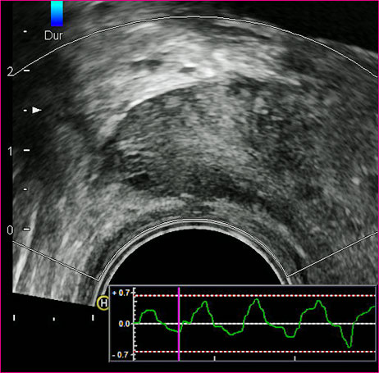
PROSTATE US ELASTOGRAPHY Limitations
• Strain elastography: - lack of uniform compression (micro-convex shape) - diffuse cancer disease - operator dependency - slippage artifact: mismatch between pre and post compression planes - training

Slide 29
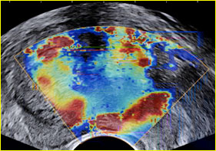
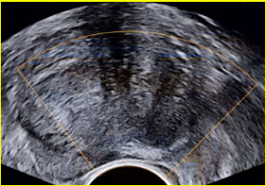
PROSTATE US ELASTOGRAPHY Limitations
• SW elastography: - pressure artifacts (induced by end-fire transducer) - slow frame rate (1 image per second) - limited size of the ROI (half prostate covered) - delay for signal stabilization at each acquisition plane - signal attenuation in large prostates (anterior gland)
• Intrinsic limitations (any prostate elastography technique): - Not all cancers are stiff - All stiff lesions are not cancers (calcifications, fibrosis…). => Elasticity information must be combined with B-mode findings

Slide 30
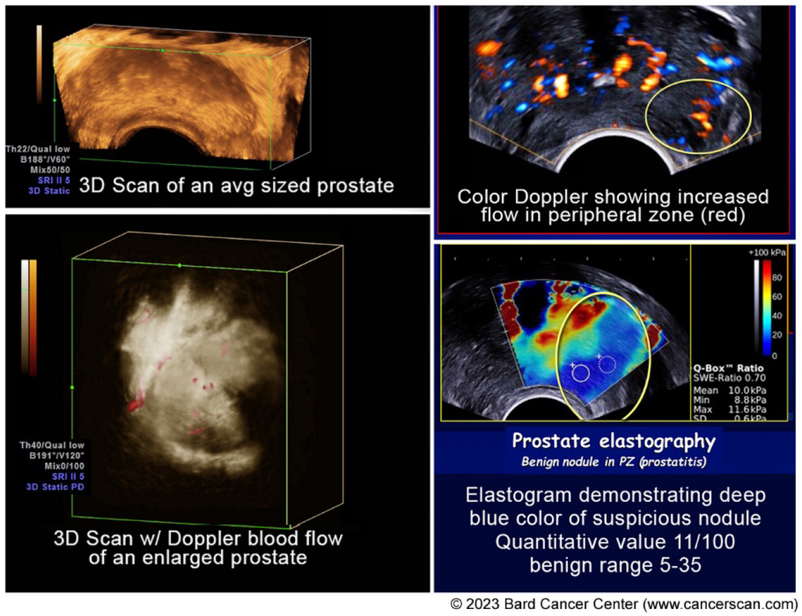
IMAGE GUIDED APPROACH TO THE TREATMENT OF PROSTATE HYPERPLASIA
PSA Readings
vs. Clinical Imaging

Slide 31
Updated from the original presentation @ The 109TH ANNUAL MEETING ARRS BOSTON (2009)
Presented at the 2023 PROTON RADIATION CENTER SYMPOSIUM-NEW YORK
3-Dimensional Doppler Sonography
and DCE-MRI of Recurrent Prostate
Cancer Following HIFU Therapy
ROBERT L. BARD, MD, DABR, FAIUM, FALSMS
Chair – Therapeutic Ultrasound Committee of the AIUM, USA
JELLE O. BARENTSZ, MD
Chair of Radiology Research / UMC St Ramboud, The Netherlands

Slide 32
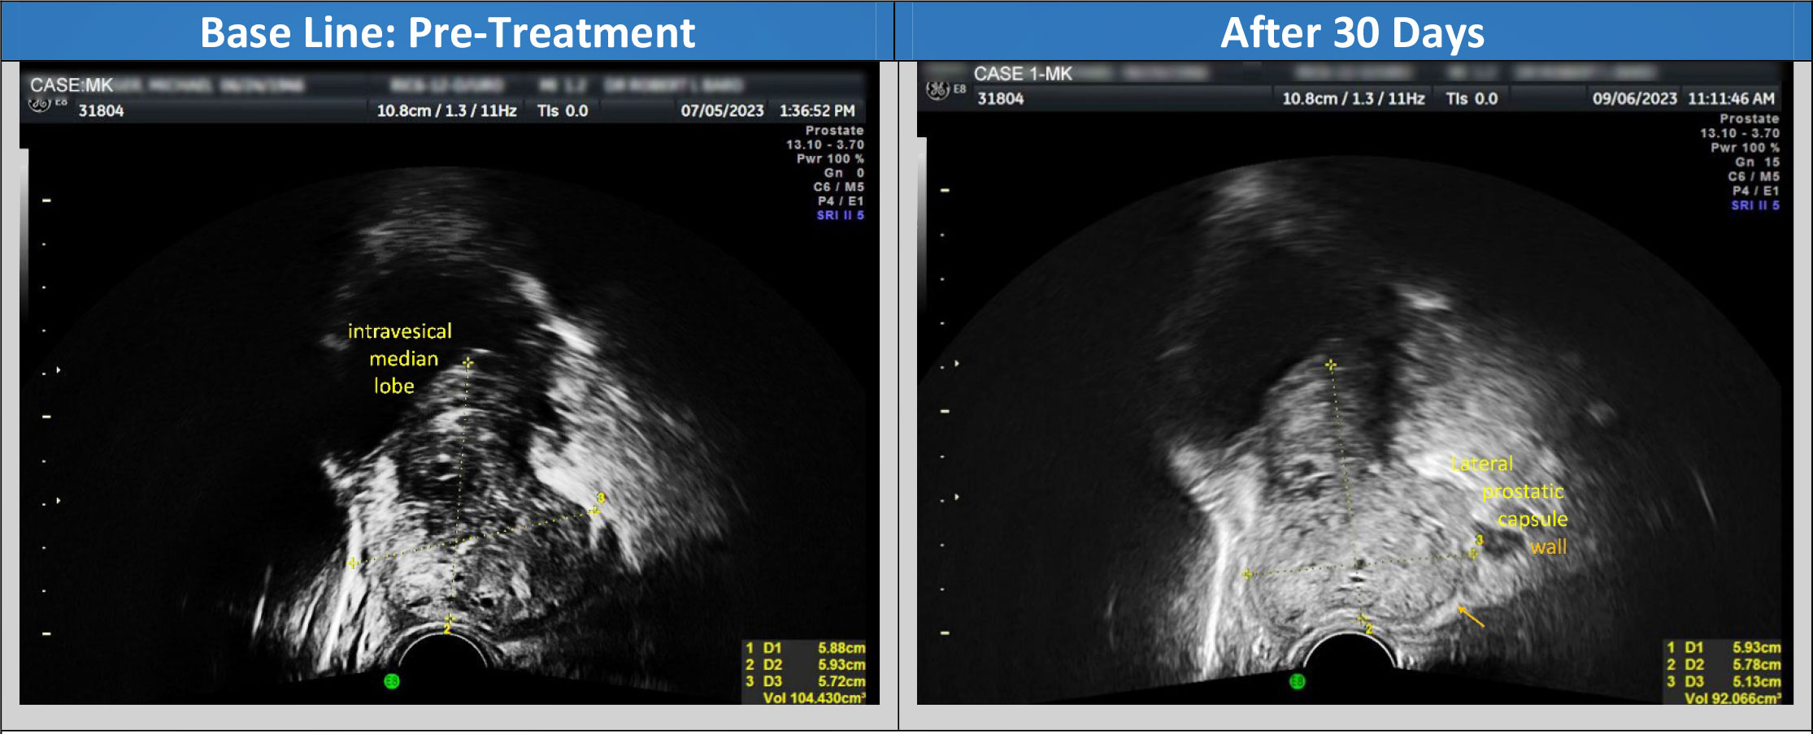
Case study 1: Caucasian male, 69 years old
SONOGRAM: RE+ right psa elevated Comparison 7/5/23 1 month PEMF
Time out: risks/benefits/possibility of false positives discussed
Prostate, bladder and pelvic paraprostatic spectral Doppler vascular study was performed using transrectal 4D real time b mode
examination, power Doppler, spectral flows and 3D workstation analysis. This report sequence was limited to volumetric changes based on non invasive therapies. Dre=+/- left
Prostate volume comparison (Reduction- 12cc) - BPH DECREASED
Previous pre-treatment prostate vol: 104 cc | Current post treatment prostate vol: 92 cc
Vascular area: r lateral 9x7 prev 9x7 mm. VI=1% unchanged Vessel Index is a quantitative measure of inflammatory or malignant vessels. Note the absence of increased vascularity in the 9x7 mm focus signifies no evidence of abnormally induced vessel related adverse effects over the one month study period.

Slide 33
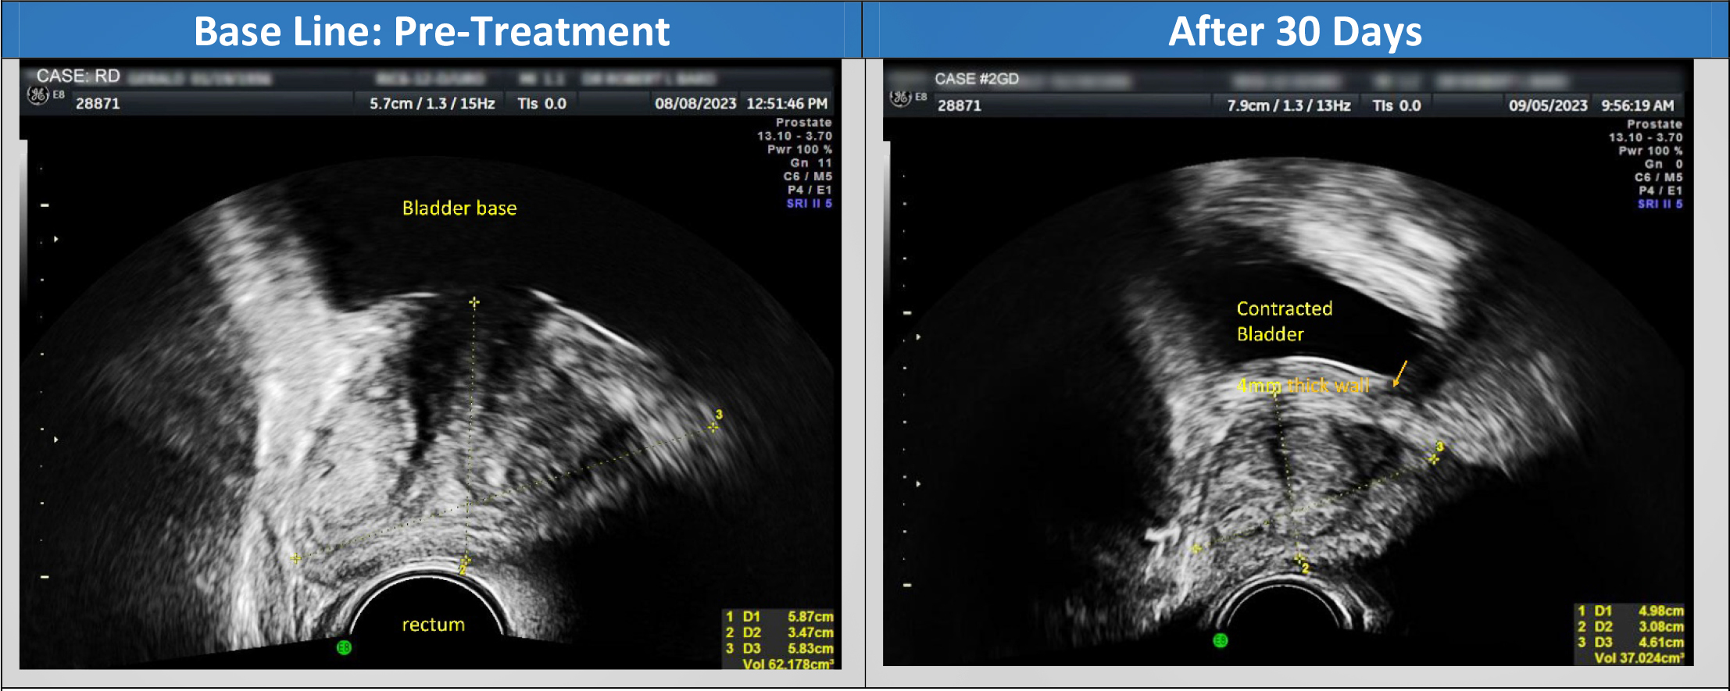
Case study 2: Caucasian male, 87 years old
SONOGRAM BLADDER / PROSTATE
BLADDER‐PEMF 1 month comparison 8/8/23
Prostate volume comparison (Reduction- 15cc - wall thickness removed) - BPH DECREASED
Previous pre‐treatment prostate vol: 62 cc included wall | Current post treatment prostate vol: 37cc
Volume measurements of the gland are influenced by bladder wall thickness as the tissues are adjacent.
The use of 3D multiplanar real time imaging permits clear delineation of these structures

Slide 34
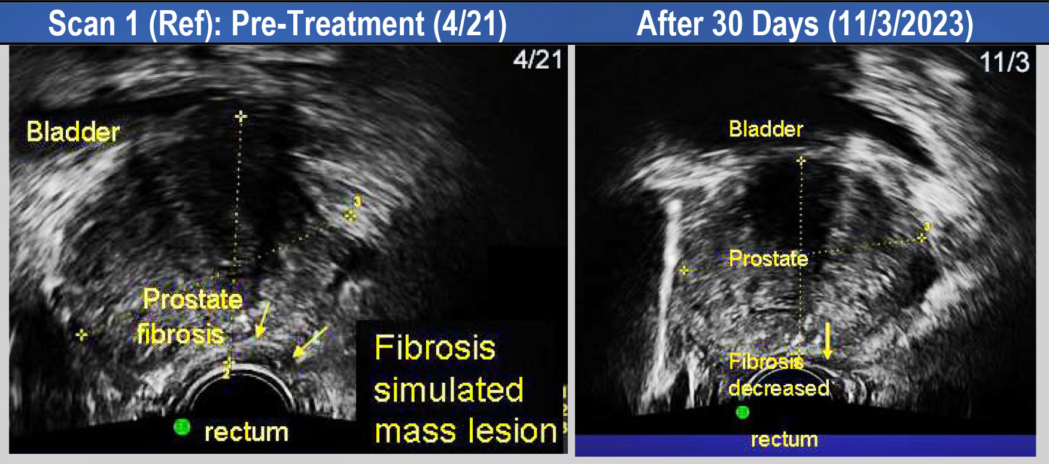
Case study 4: Caucasian male, 69 years old
Hx: dysuria comparison 9/22, 4/23 PEMF treatment | Urgency decreased flow increased
TIME OUT: risks/benefits/possibility of false positives discussed
Prostate, bladder and pelvic paraprostatic spectral Doppler vascular study was performed using transrectal 4D real
time B-mode examination, power Doppler, spectral flows and 3D workstation analysis.
DRE: Digital Rectal Exam: regular no mass noted. Vascular area: none. Avascular area: none
Prostate volume comparison (Reduction- 16cc) - BPH DECREASED
Base line Protate volume: 100cc | Current Prostate volume: 84 cc

Slide 35
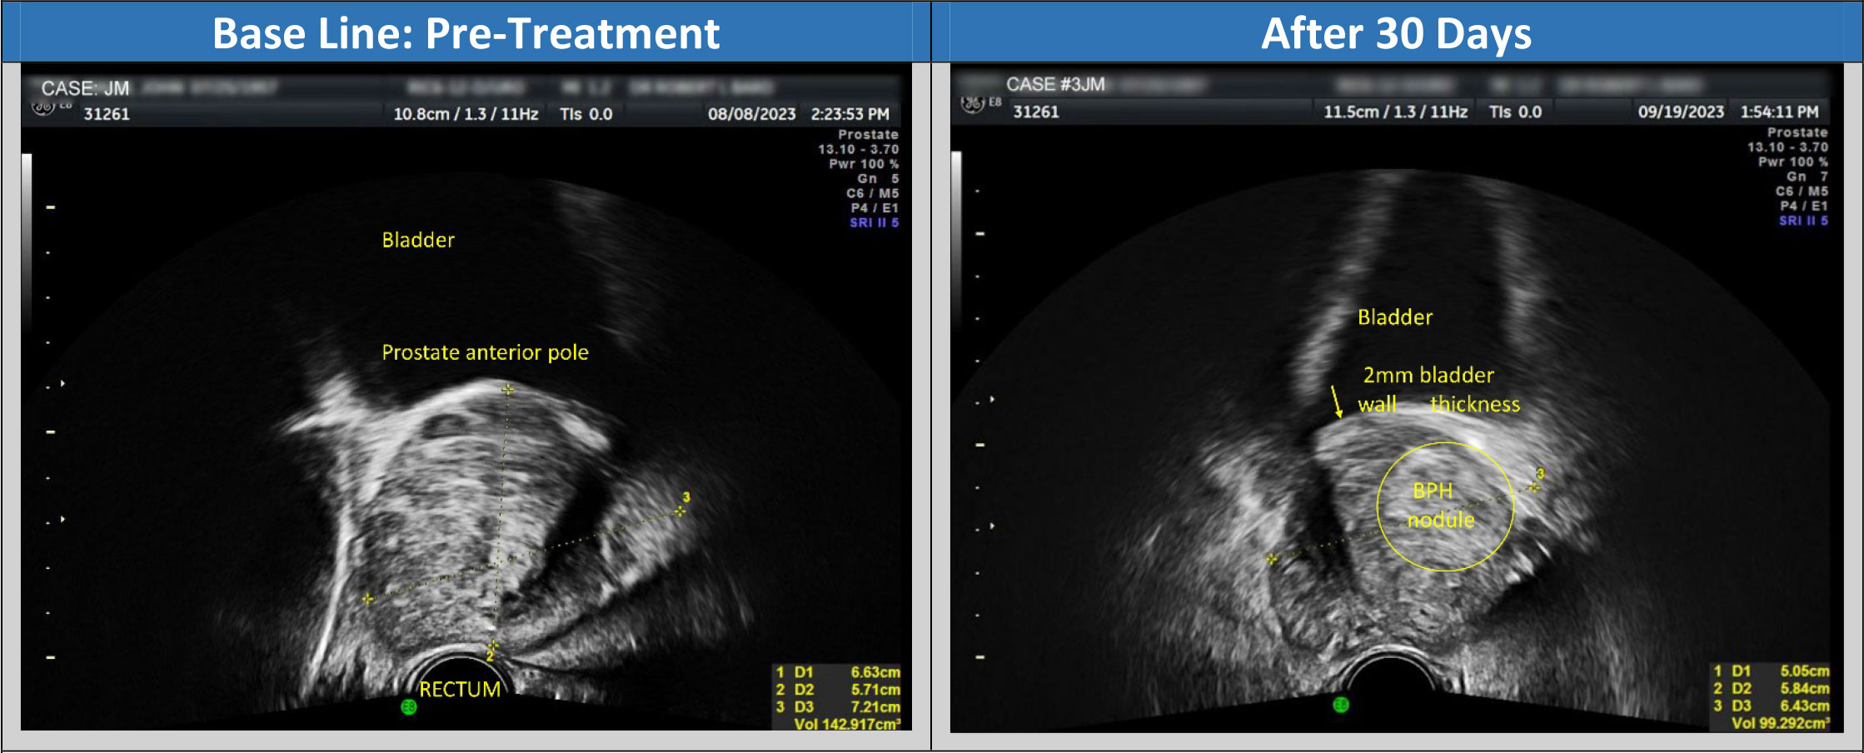
Case study 3: Caucasian male, 71 years old
SONOGRAM BLADDER / PROSTATE Comparison 8/8/23
Hx: DRE +/‐ right midgland bph pemf
Time out: risks/benefits/possibility of false positives discussed. Prostate and pelvic paraprostatic spectral Doppler
vascular study was performed using transrectal 4D real time b mode examination, power Doppler, spectral flows and 3D workstation analysis.
Prostate volume comparison (Reduction- 43cc) - BPH DECREASED
Pre‐treatment prostate vol: 143 cc | Post‐treatment prostate vol: 100 cc
As the benign glandular hypertrophy and/or inflammatory findings respond to therapy additional pathology may be
discerned, ie, in this case a 2cm echogenic benign nodule is clearly identified.

Slide 36
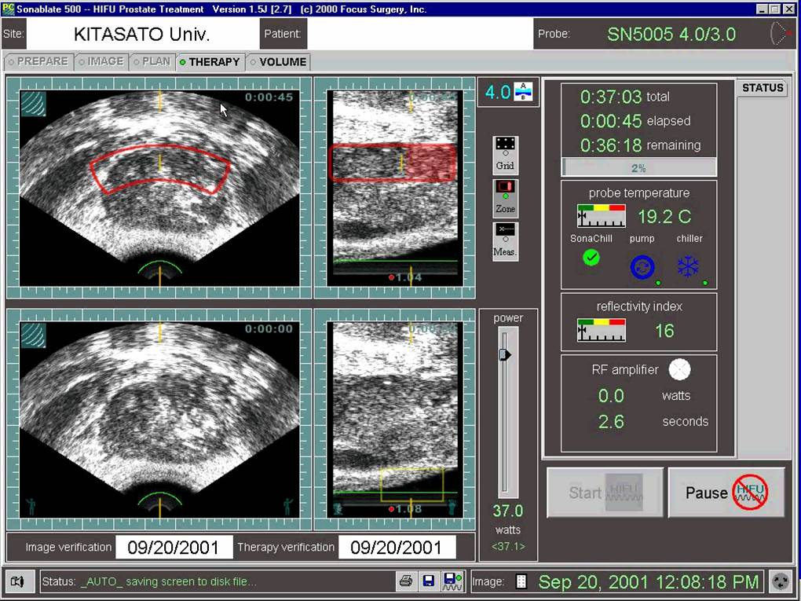
HIFU Treatment Protocol 20CC/Hour

Slide 37
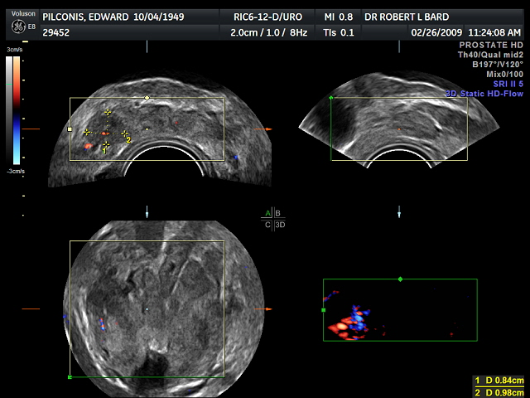
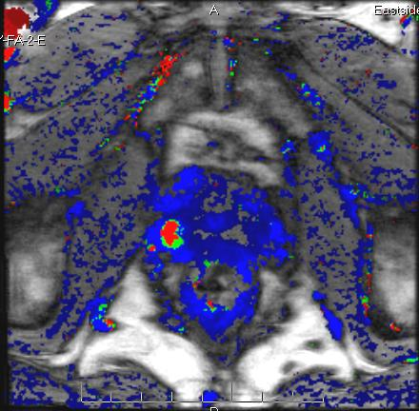
Post HIFU 2yr for LEFT GL3 New GL4 right base noted

Slide 38
Recurrent Gleason 5 with right inferior pubic ramus disease

Slide 39
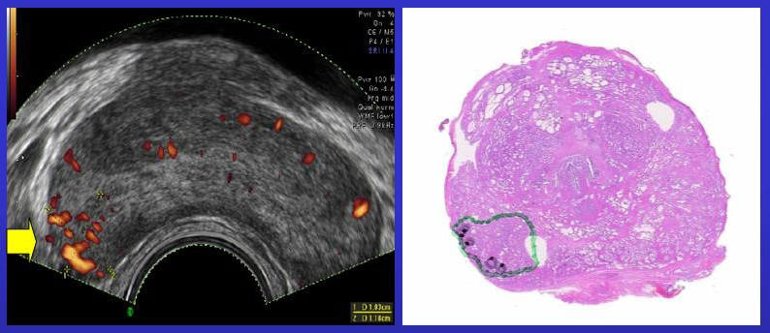
Tumor invades into but not beyond capsule
(Yellow right arrow denotes prostate capsule)
Green=GL 5,6 Black=GL 7,8,9

Slide 40
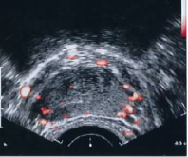
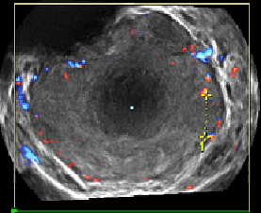
Comparison of 2D Color Doppler with
3D Power Doppler
2D Color Doppler 3D Power Doppler
Right base tumor palpable
▪ 2D shows right capsule erosion as loss of
white circumferential line (arrow)
▪ 3D shows left non-palpable lesion 9mm
(double arrows)

Slide 41
Vascular Regression
HIFU-IMMEDIATE
RFA-IMMEDIATE
CRYOSURGERY-IMMEDIATE
ANTIOXIDANT 1-4 MONTHS
HORMONES 1-9 MONTHS
RADIATION 2-6 MONTHS
IRREVERSIBLE ELECTROPORATION
(under study since June 2008)

Slide 42
DCE MRI HIFU Recurrence
RASMUSSEN
Same patient as in last slide GL 5 2ND HIFU

Slide 43
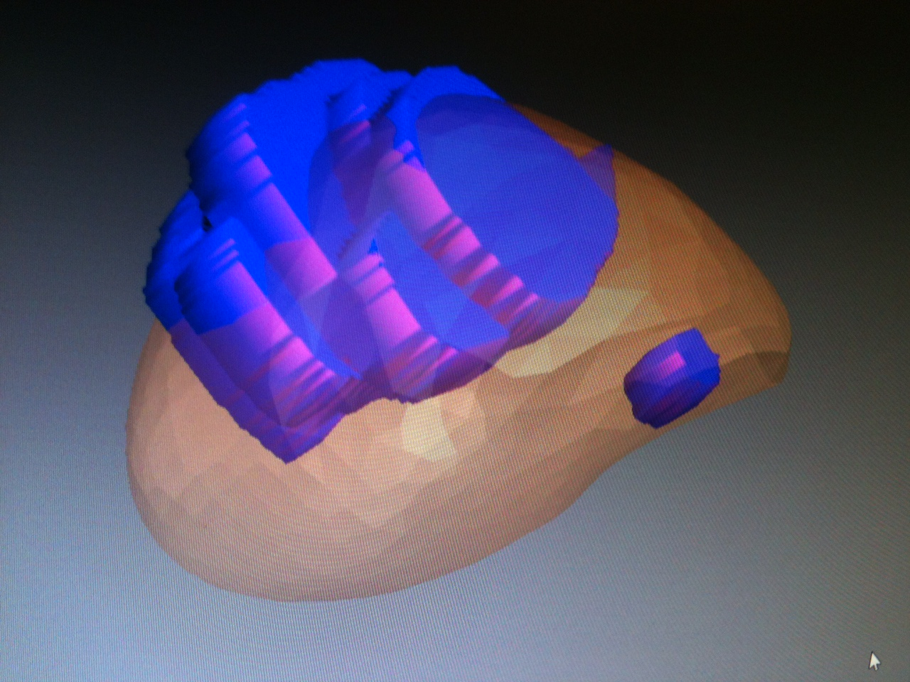
2011-Boston-Biopsy core missed Gleason 8-Fusion Rx

Slide 44
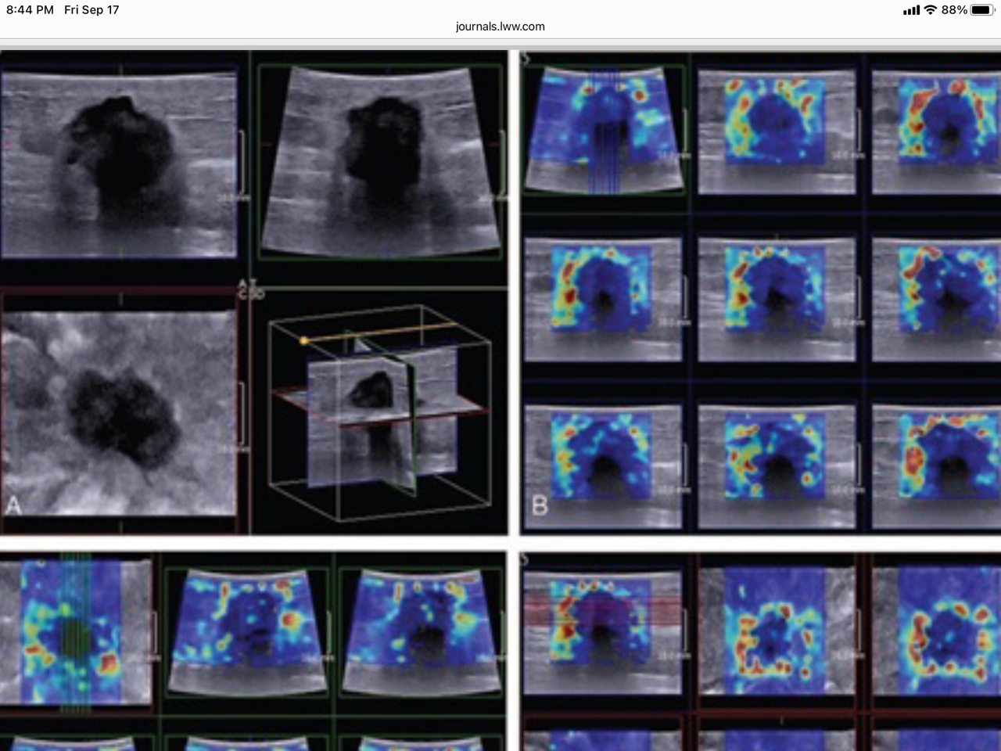
Crater Sign-3D Elastography

Slide 45
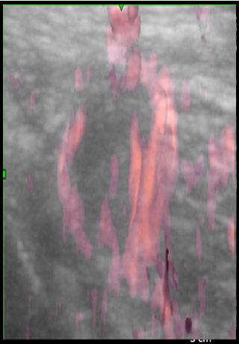
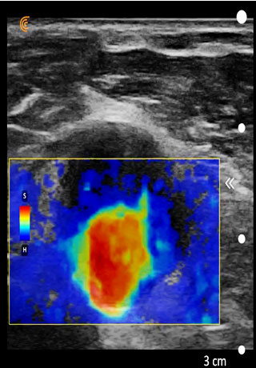
ENDOMETRIAL CANCER Nodal Metastasis 25 yrs post rx
nodule
fluid

Slide 46
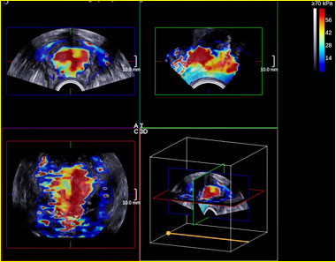
CONCLUSION
• Limited performance of TRUS in prostate imaging
• Elastography: useful modality evaluating tissue stiffness to avoid biopsy and 6 mo follow up
• US elastography: feasible+additional performance for: - characterization of an abnormal area/nodule detected at MRI/ conventional US/ CDUS/ CE-US - detection of a stiff area - TRUS guided biopsies
• Future perspectives: - volumetric (3D/4D) prostate elastography with MPR reconstruction and volumetric fusion to MP-MRI (only possible with SWE) => focal therapy with microvessel verification
Bioenergy treatment with Aurawell (image by Siemens)

Slide 47
Originally presented in:
The American Institute of Ultrasound in Medicine 2015 PreConvention March 21- 25 Orlando
Elastography: State of the Art 2015

